Slide 1
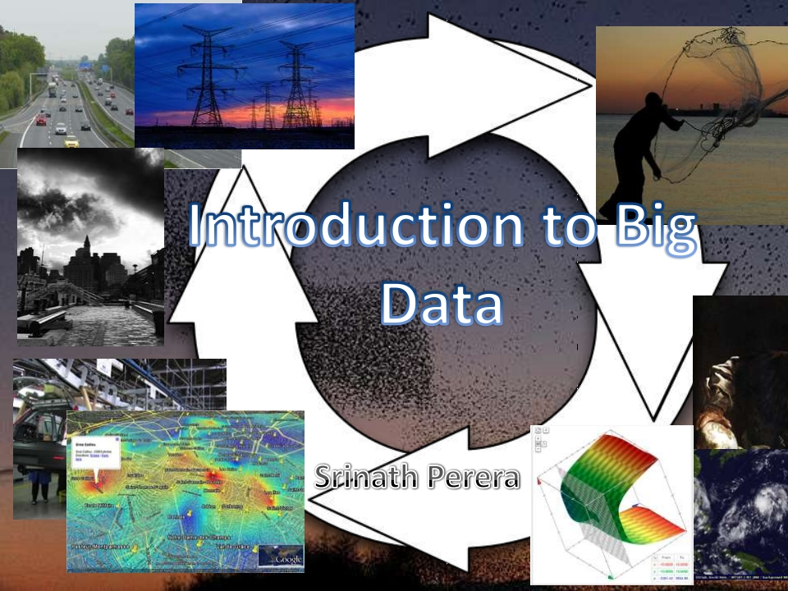
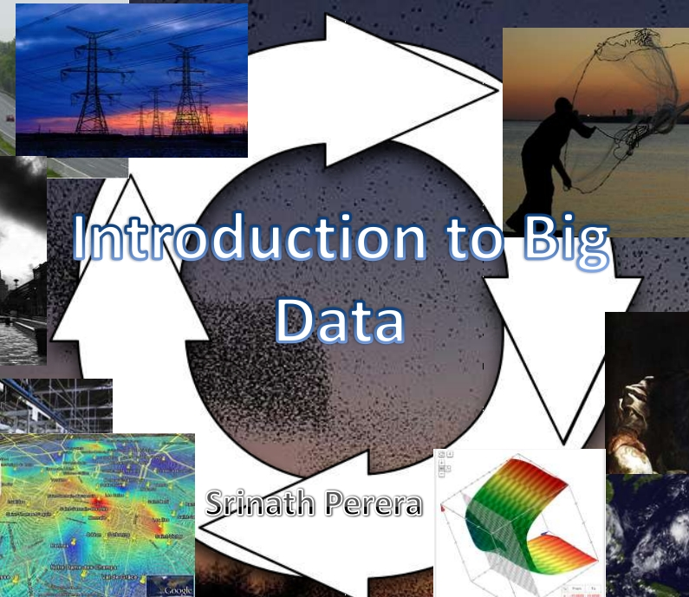

Slide 2
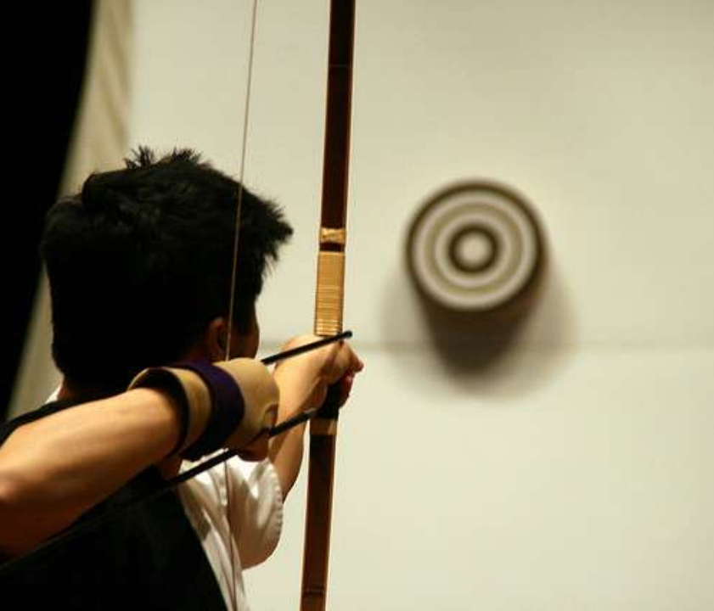
O u tline • Forecasts and
Why Big data?
•
•
•
•
What is Big
Data?
Parts of the
Puzzle
Quick Tutorial
Conclusion
Photo by John Trainoron Flickr
http://www.flickr.com/photos/trainor/2902023575/, Licensed under CC

Slide 3

Asimov Foundation
• 20 million worlds
• A Scientist who
mathematically calculate
the fate of the Universe
• His effort to change that
Fate
• A Beautiful story

Slide 4
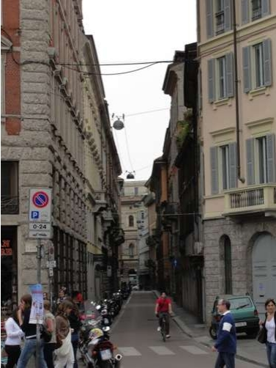
Consider a day in your life
• What is the best road to take?
• Would there be any bad
weather?
• What is the best way to invest
the money?
• Should I take that loan?
• Can I optimize my day?
• Is there a way to do this
faster?
• What have others done in
similar cases?
• Which product should I buy?

Slide 5
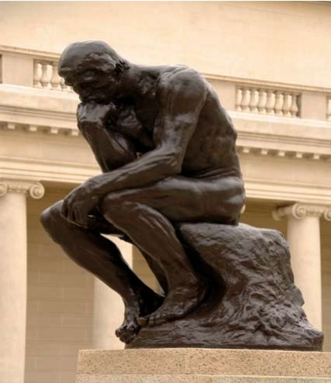
People wanted to (through ages)
• To know (what
happened?)
• To Explain (why it
happened)
• To Predict (what will
happen?)

Slide 6
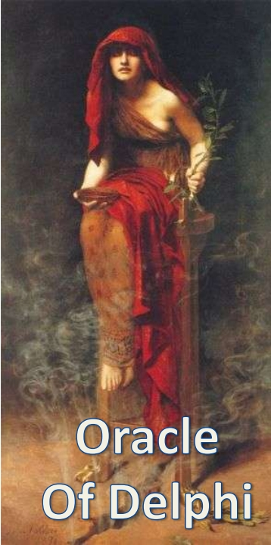
Many Cultures had
Claim for Omniscience
Oracle
Astrology
Book of Changes
Tarot Cards
Crystal balls
Claim for Omniscience
•
•
•
•
•

Slide 7
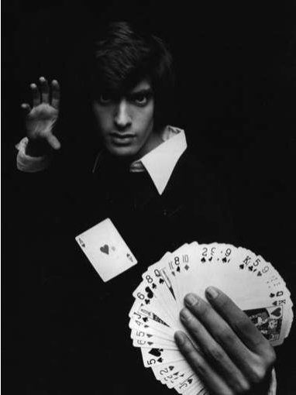
To know, explain and predict!!
• Grand challenge of our time
• We have been trying to do this in
many other means
• Now we trying to do this via
science
Any sufficiently advanced technology
is indistinguishable from magic.
---Arthur C. Clarke.
• We see a possibilities though “lot
of data”

Slide 8
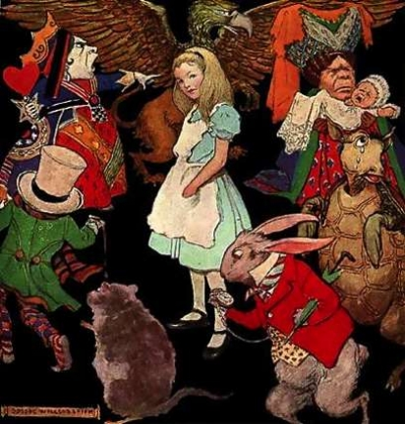
You does not seem to be convinced!!
• Why, sometimes I've believed as many as six
impossible things before breakfast.

Slide 9
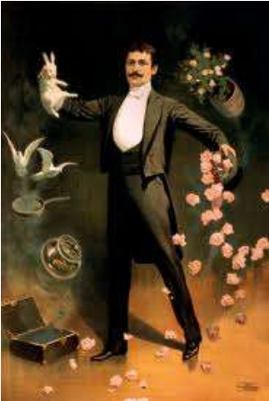
Prophecies of our time
• We can predict Weather
• We do understand language
translation pretty well
• We can predict how an air
plane behave good enough to
fly
• Our ability on forensics
• We understand remedies for
many diseases
• We can tell how astro bodies
will behave (e.g. comets)

Slide 10
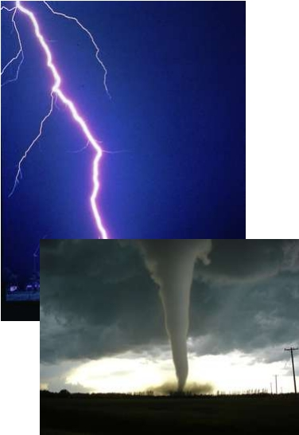
This is being Done: Weather
• Remarkably accurate for few
days
– SL incident
• Data :- weather radars, satellite
data, weather balloons, planes
etc.,
• forecast models
– Simulation
– Numerical method
• Challenge is computing power
– algorithms that take more than
24 hours
– resolution is the key ……

Slide 11
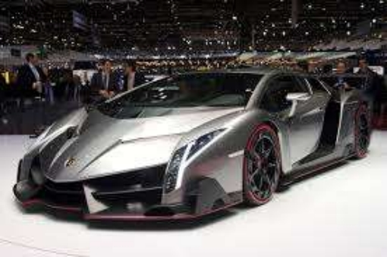
Democratizing Analysis
• Forecasting was done, but in limited manner
and only by few (e.g. National Labs,
Intelligence community)
• That is changing!!

Slide 12
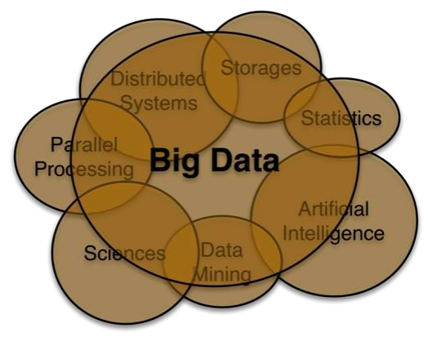
What is Big data?
• There is lot of data available
– E.g. Internet of things
• We have computing power
• We have technology
• Goal is same
– To know
– To Explain
– To predict
• Challenge is the full lifecycle

Slide 13
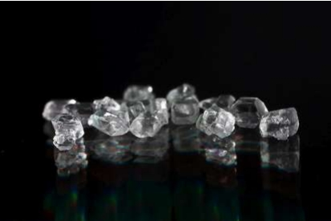
Data, the wealth of our time
"Data is a precious
thing because they last
longer than systems” -
Tim Barnes Lee
• Access to data is becoming ultimate
competitive advantage
– E.g. Google+ vs. Facebook
– Why many organizations try hard to give us free
things and keep us always logged in (e.g. Gmail,
facebook, search engine tool bars)

Slide 14
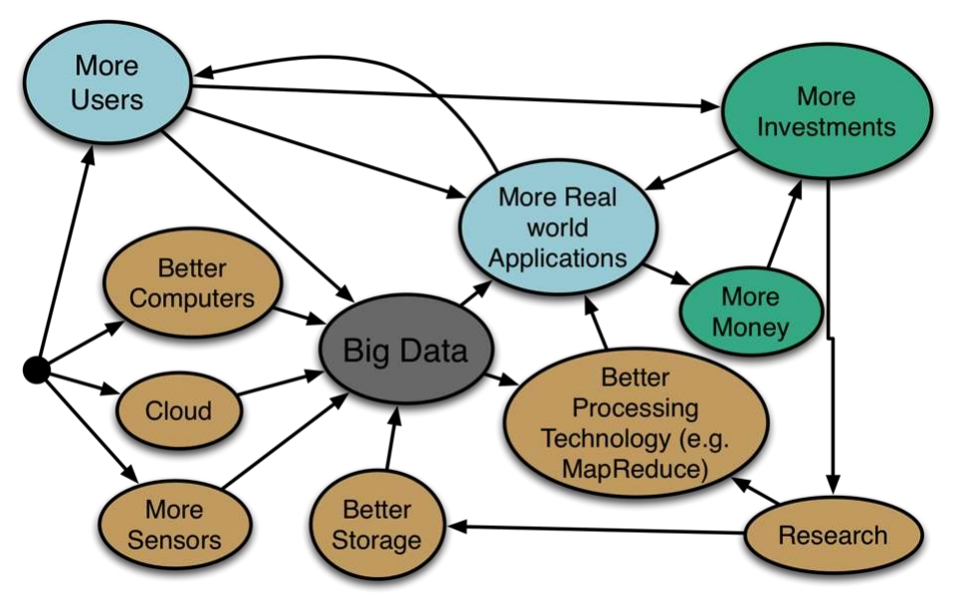
Drivers of Big Data

Slide 15
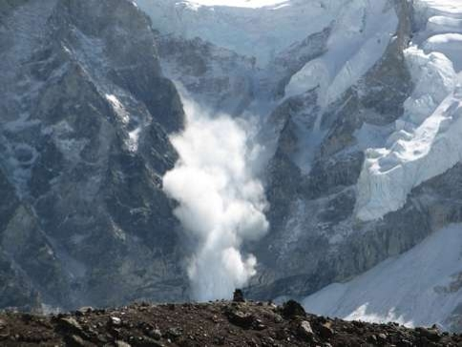
Data Avalanche/ Moore’s law of data
• We are now collecting and converting large amount
of data to digital forms
• 90% of the data in the world today was created
within the past two years.
• Amount of data we have doubles very fast

Slide 16
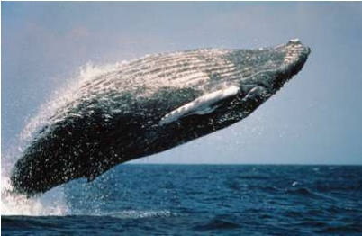
In real life, most data are Big
• Web does millions of activities per second, and so
much server logs are created.
• Social networks e.g. Facebook, 800 Million active
users, 40 billion photos from its user base.
• There are >4 billion phones and >25% are smart
phones. There are billions of RFID tags.
• Observational and Sensor data
–
–
–
–
Weather Radars, Balloons
Environmental Sensors
Telescopes
Complex physics simulations

Slide 17
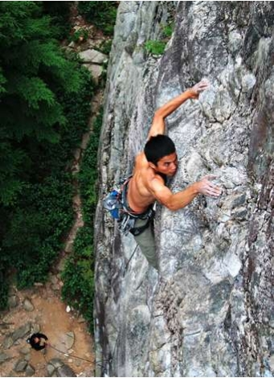
Why Big Data is hard?
• How store? Assuming 1TB bytes it
takes 1000 computers to store a 1PB
• How to move? Assuming 10Gb
network, it takes 2 hours to copy 1TB,
or 83 days to copy a 1PB
• How to search? Assuming each record
is 1KB and one machine can process
1000 records per sec, it needs 277CPU
days to process a 1TB and 785 CPU
years to process a 1 PB
• How to process?
– How to convert algorithms to work in large
size
– How to create new algorithms
http://www.susanica.com/photo/9

Slide 18
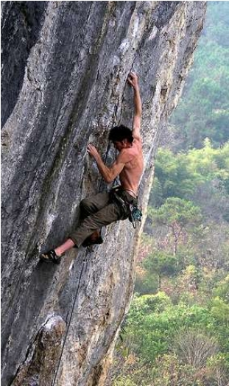
Why it is hard (Contd.)?
• System build of many
computers
• That handles lots of data
• Running complex logic
• This pushes us to frontier of
Distributed Systems and
Databases
• More data does not mean
there is a simple model
• Some models can be complex
as the system
http://www.flickr.com/photos/mariachily/5250487136 ,
Licensed CC

Slide 19
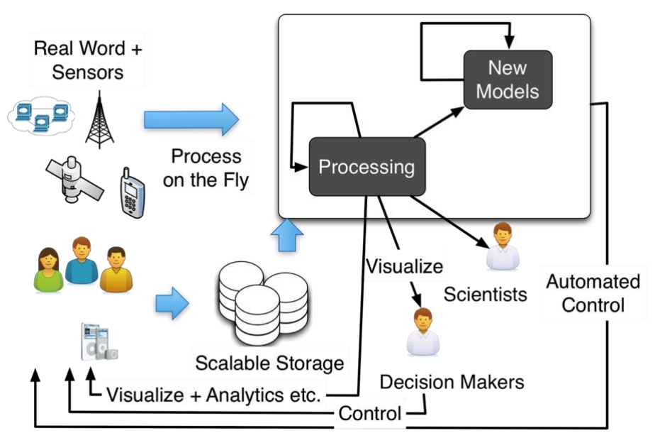
Big Data Architecture

Slide 20
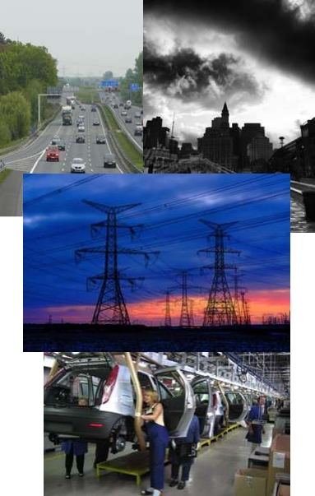
Sensors
• There are sensors everywhere
– RFID (e.g. Walmart), GPS
sensors, Mobile Phone …
• Internet
– Click streams, Emails, chat,
search, tweets ,Transactions …
• Real Word
– Video surveillance, Cash flows,
Traffic, Surveillance, Stock
exchange, Smart Grid,
Production line …
– Internet of Things
http://www.flickr.com/photos/imuttoo/4257813689/ by Ian Muttoo,
http://www.flickr.com/photos/eastcapital/4554220770/ ,
http://www.flickr.com/photos/patdavid/4619331472/ by Pat David copyright CC

Slide 21
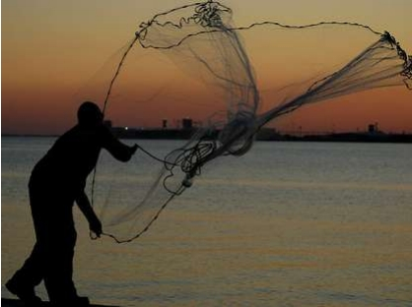
Collecting Data
• Data collected at sensors and sent to big data
system via events or flat files
• Event Streams: we name the events by its
content/ originator
• Get data through
– Point to Point
– Event Bus
• E.g. Data bridge
– a thrift based transport we
did that do about 400k
events/ sec

Slide 22
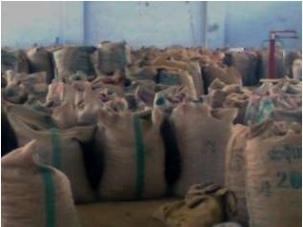
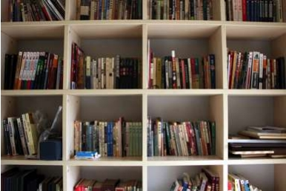
Storing Data
• Historically we used databases
– Scale is a challenge: replication,
sharding
• Scalable options
– NoSQL (Cassandra, Hbase) [If
data is structured]
• Column families Gaining Ground
– Distributed file systems (e.g.
HDFS) [If data is unstructured]
• New SQL
– In Memory computing, VoltDB
• Specialized data structures
– Graph Databases, Data structure
servers
http://www.flickr.com/photos/keso/3631339
67/

Slide 23
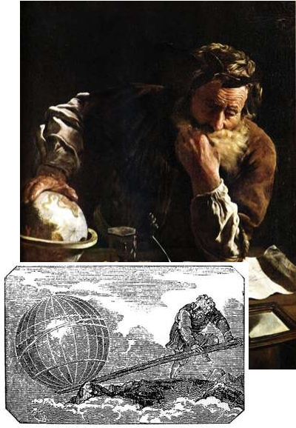
Making Sense of Data
• To know (what happened?)
– Basic analytics +
visualizations (min, max,
average, histogram,
distributions … )
– Interactive drill down
• To explain (why)
– Data mining, classifications,
building models, clustering
• To forecast
– Neural networks, decision
models

Slide 24
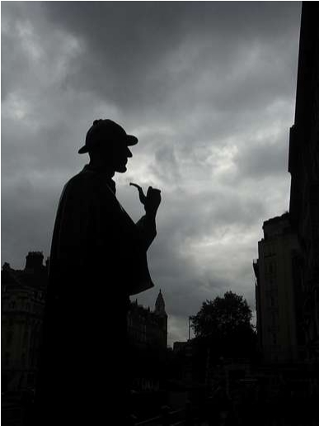
To know (what happened?)
• Mainly Analytics
– Min, Max, average,
correlation, histograms
– Might join group data in many
ways
• Implemented with
MapReduce or Queries
• Data is often presented with
some visualizations
• Examples
– forensics
– Assessments
– Historical data/ reports/
trends
http://www.flickr.com/photos/isriya/2967310
333/

Slide 25
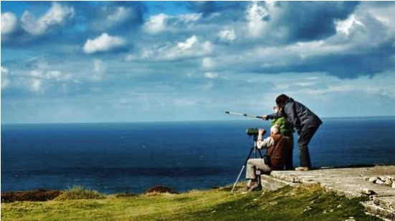
Search
• Process and Index the data. The killer app of
our time.
• Web Search
• Graph Search
• Semantic Search
• Drug Discovery
• …
http://pixabay.com , by Steven Iodice

Slide 26
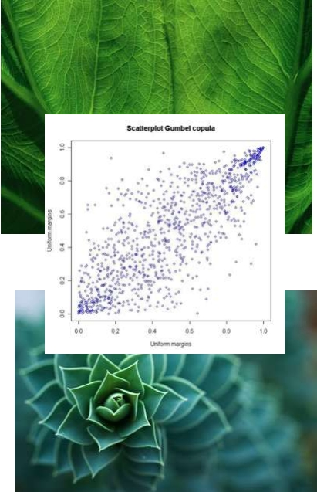
Patterns
• Correlation
– Scatter plot, statistical
correlation
• Data Mining (Detecting
Patterns)
– Clustering and classification
– Finding Similar items
– Finding Hubs and authorities
in a Graph
– Finding frequent item sets
– Making recommendation
• Apache Mahout
http://www.flickr.com/photos/eriwst/2987739376/ and http://www.flickr.com/photos/focx/5035444779/

Slide 27
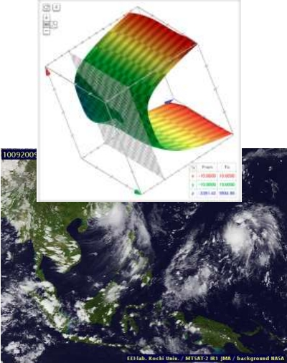
Forecasts and Models
• Trying to build a model for the
data
• Theoretically or empirically
–
–
–
–
Analytical models (e.g. Physics)
Neural networks
Reinforcement learning
Unsupervised learning (clustering,
dimensionality reduction, kernel
methods)
• Examples
–
–
–
–
–
Translation
Weather Forecast models
Building profiles of users
Traffic models
Economic models
• Remember: Correlation does not
mean causality
http://misterbijou.blogspot.com/201
0_09_01_archive.html

Slide 28
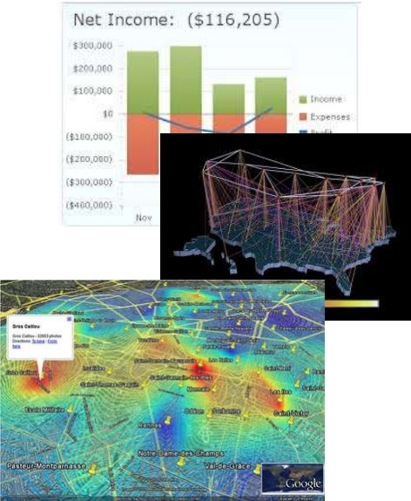
Information Visualization
• Presenting information
– To end user
– To decision takers
– To scientist
• Interactive exploration
• Sending alerts
http://www.flickr.com/photos/stevefae
embra/3604686097/

Slide 29
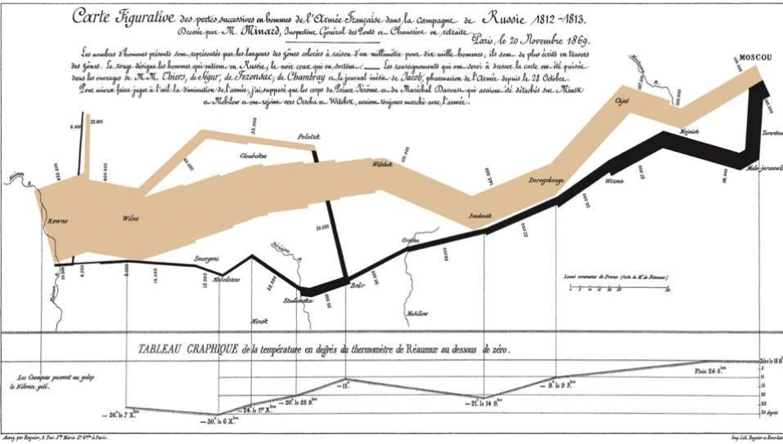
Napoleon's Russian Campaign

Slide 30
Show Han Rosling ’s Data
• This use a tool called “ Gapminder ”

Slide 31
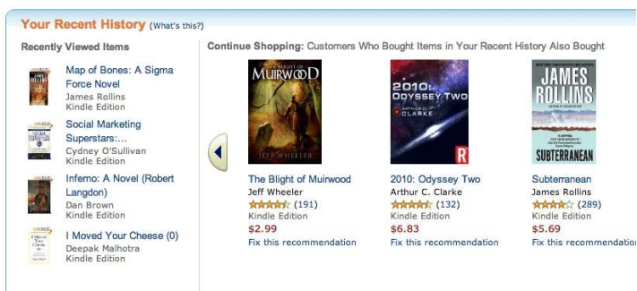
Usecase 1: Targeted Marketing
• Collect data and build a model on
– What user like
– What he has brought
– What is his buying power
• Making recommendations
• Giving personalized deals

Slide 32
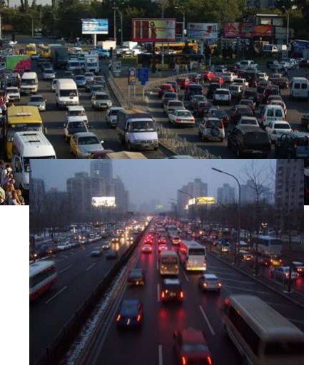
Usecase 2: Travel
• Collect traffic data +
transportation data from
sensors
• Build a model (e.g. Car
Following Models)
• Predict the traffic ..
Possibilities on congestion
• E.g. divert traffic, adjust
troll, adjust traffic lights

Slide 33
Practical Tutorial
• Data collection
– Pub/sub, event architectures
• Processing
– Store and Process: MapReduce/Hadoop
– Processing Moving Data: CEP
• Visualization
– GNU Plot/ R

Slide 34
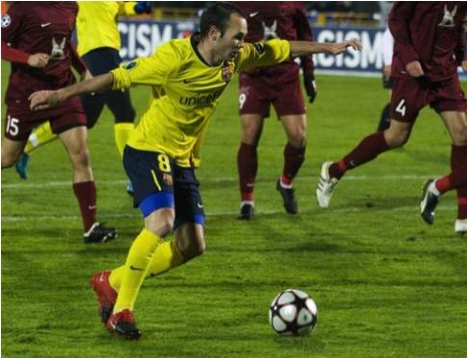
DEBS Challenge
• Event Processing
challenge
• Real football game,
sensors in player
shoes + ball
• Events in 15k Hz
• Event format
– Sensor ID, TS, x, y, z, v,
a
• Queries
–
–
–
–
Running Stats
Ball Possession
Heat Map of Activity
Shots at Goal

Slide 35
MapReduce/ Hadoop
• First introduced by Google,
and used as the processing
model for their architecture
• Implemented by opensource
projects like Apache Hadoop
and Spark
• Users writes two functions:
map and reduce
• The framework handles the
details like distributed
processing, fault tolerance,
load balancing etc.
• Widely used, and the one of
the catalyst of Big data
void map(ctx, k, v){
tokens = v.split();
for t in tokens
ctx.emit(t,1)
}
void reduce(ctx, k, values[]){
count = 0;
for v in values
count = count + v;
ctx.emit(k,count);
}

Slide 36
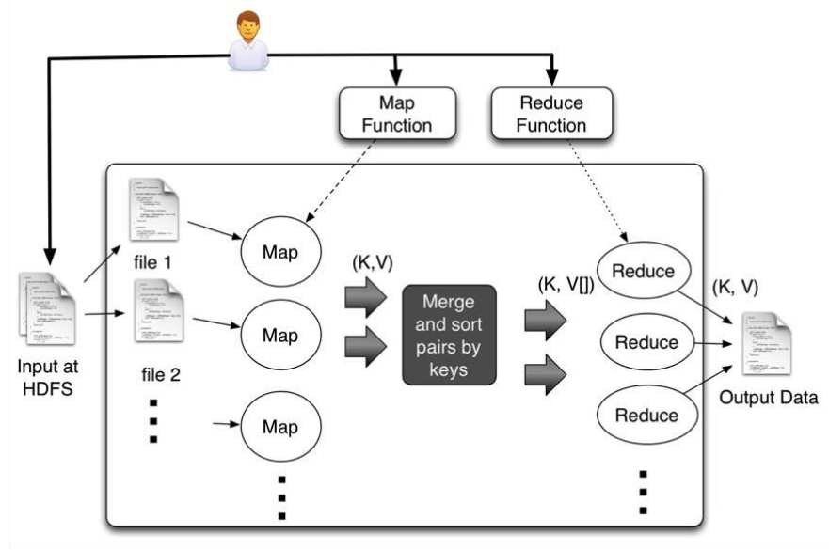
MapReduce (Contd.)

Slide 37
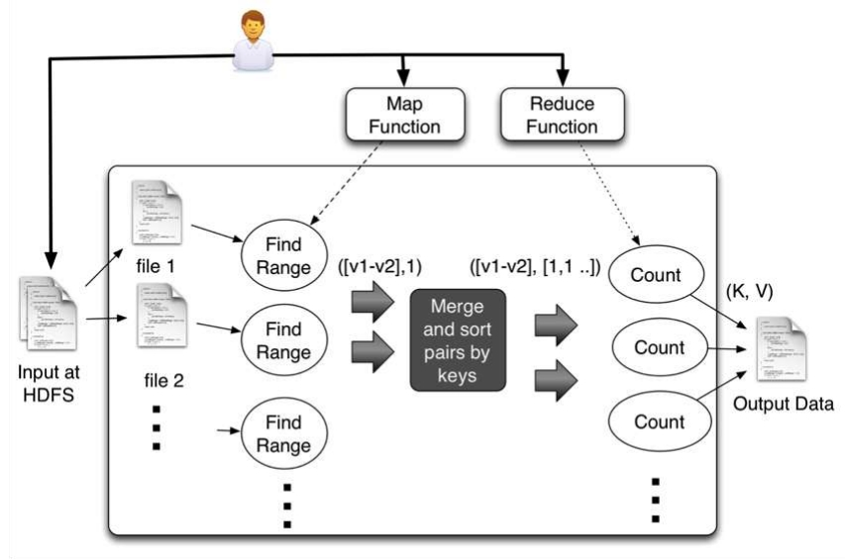
Histogram of Speeds

Slide 38
Histogram of Speeds(Contd.)
void map(ctx, k, v){
event = parse(v);
range = calcuateRange(event.v);
ctx.emit(range,1)
}
void reduce(ctx, k, values[]){
count = 0;
for v in values
count = count + v;
ctx.emit(k,count);
}

Slide 39
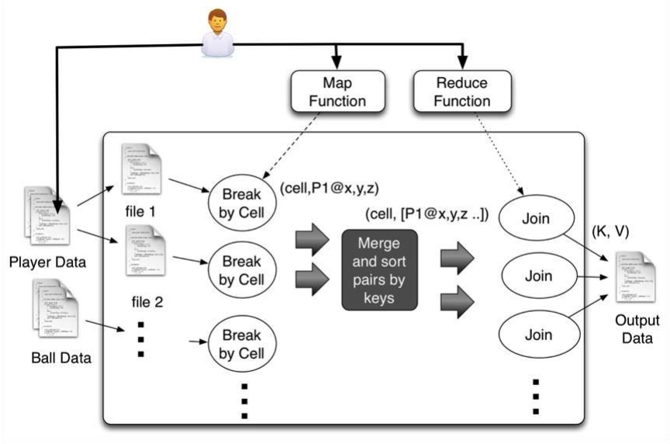
How long player Spend Near the ball?

Slide 40
How long player Spend Near the
ball?(Contd.)
void map(ctx, k, v){
event = parse(v);
cell = calcuateOverlappingCells(v.x,
v.y, v.z);
ctx.emit(cell,v.x, v.y, v.z);
}
Void reduce(ctx, k, values[]){
players = joinAndFindPlayersNearBall(values);
for p in players
ctx.emit(p,p);
}

Slide 41
Hadoop Landscape
• HIVE - Query data using SQL style queries, and Hive will
convert them to MapReduce jobs and run in Hadoop.
hive> SELECT country, gni from HDI WHERE gni > 2000;
• Pig - We write programs using data flow style scripts, and
Pig convert them to MapReduce jobs and run in Hadoop.
A = load 'hdi-data.csv' using PigStorage(',')
AS (id:int, country:chararray, hdi:float,
lifeex:int, mysch:int, eysch:int, gni:int);
B = FILTER A BY gni > 2000;
C = ORDER B BY gni;
dump C;
• Mahout
– Collection of MapReduce jobs implementing many Data
mining and Artificial Intelligence algorithms using MapReduce

Slide 42
Is Hadoop Enough?
• Limitations
–
–
–
–
Takes time for processing
Lack of Incremental processing
Weak with Graph usecases
Not very easy to create a processing pipeline (addressed
with HIVE, Pig etc.)
– Too close to programmers
– Faster implementations are possible
• Alternatives
– Apache Drill http://incubator.apache.org/drill/
– Spark http://spark-project.org/
– Graph Processors like http://giraph.apache.org/

Slide 43
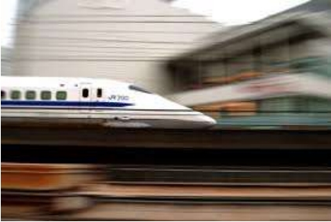
Data In the Move
• Idea is to process data as they
are received in streaming
fashion
• Used when we need
– Very fast output
– Lots of events (few 100k to
millions)
– Processing without storing (e.g.
too much data)
• Two main technologies
– Stream Processing (e.g. Strom,
http://storm-project.net/ )
– Complex Event Processing (CEP)
http://wso2.com/products/complex
-event-processor/

Slide 44
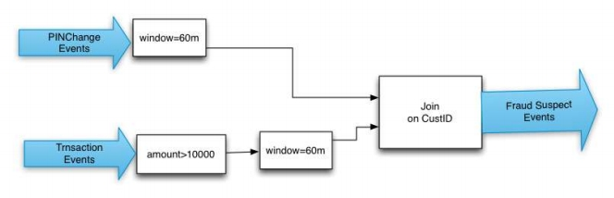
Complex Event Processing (CEP)
• Sees inputs as Event streams and queried with
SQL like language
• Supports Filters, Windows, Join, Patterns and
Sequences
from p=PINChangeEvents#win.time(3600) join
t=TransactionEvents[p.custid=custid][amount>1000
0] #win.time(3600)
return t.custid, t.amount;

Slide 45
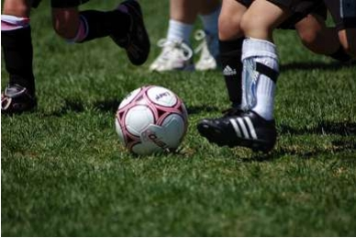
Example: Detect ball Possession
from Ball#window.length(1) as b join
Players#window.length(1) as p
unidirectional
on debs: getDistance(b.x,b.y,b.z,
p.x, p.y, p.z) < 1000
and b.a > 55
select ...
• Possession is time a
player hit the ball
until someone else
hits it or it goes out
of the ground
insert into hitStream
from old = hitStream ,
b = hitStream [old. pid != pid ],
n= hitStream[b.pid == pid]*,
( e1 = hitStream[b.pid != pid ]
or e2= ballLeavingHitStream)
select ...
insert into BallPossessionStream
http://www.flickr.com/photos/glennharper/146164820/

Slide 46
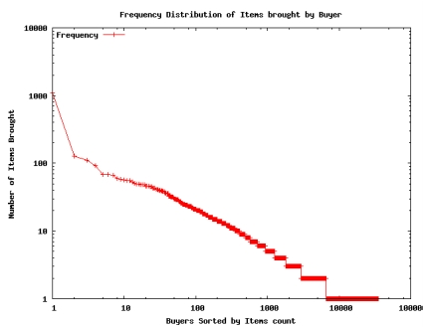
GNU Plot
set terminal png
set output "buyfreq.png"
set title "Frequency Distribution of Items
brought by Buyer";
setylabel "Number of Items Brought";
setxlabel "Buyers Sorted by Items count";
set key left top
set log y
set log x
plot "1.data" using 2 title "Frequency"
with linespoints
• Open source
• Very powerful

Slide 47
Big data lifecycle
• Realizing the big data lifecycle is hard
• Need wide understanding about many fields
• Big data teams will include members from
many fields working together

Slide 48
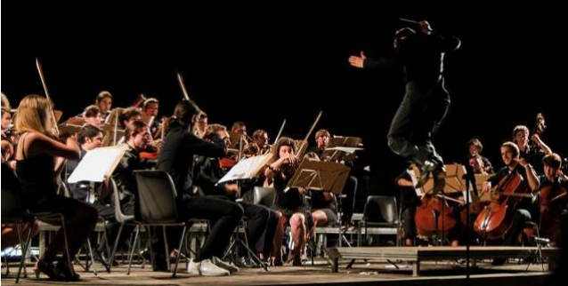
Data Scientist
AI experts
Statisticians
DB experts
System experts
Domain Experts
• Data Scientists: A new role, evolving Job
description
• His Job is to make sense of data, by using Big data
processing, advance algorithms, Statistical
methods, and data mining etc.
• Likely to be a highest paid/ cool Jobs.
• Big organizations (Google, Facebook, Banks) hiring
Math PhD by a lot for this.

Slide 49
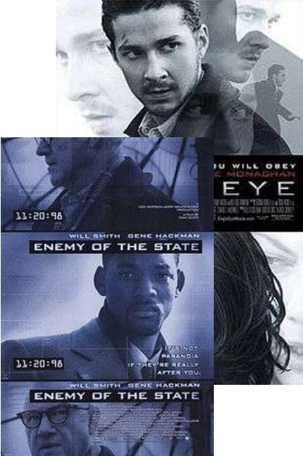
Dark Side
• Privacy
– Invasion of privacy
– Data might be used for
unexpected things
• Big Brother
– Data likely to used for
control (e.g. governments)
• If technology is out there,
may be it is OK. It is very
hard to hide any thing,
which work both ways

Slide 50
Challenges
• Speed (e.g. targeted advertising, reacting to data)
• Extracting semantics and handling multiple
representations and formats
• Security Data ownership, delegation, permissions,
and Privacy
• Making data accessible to all intended parties,
from anywhere, anytime, from any device,
through any format (subjected to permissions).
• Map-Reduce good enough? What about other
parallel problems?
• Handling Uncertainty

Slide 51
Conclusions
• Lot of data, realizing data -> insight -> predications
• We do lot of predications even now.
• There is lot between data and forecasts, OK to do
them.
–
–
–
–
Analytics
Visualizations
Patterns
Data mining
• If you looking to start, learn MapReduce, CEP, and
GNU plot.
• Visualization is the key!!
• Learn some distributed systems and AI

Slide 52
Questions?

